Slide 1
Topic: AN ANDROID APPLICATION FOR KEEPING UP WITH LATEST HEADLINES
TEAM MEMBERS: Rubert Rex P
Vishnu kanth P
Gokul Sanjay M
Kishoth B

Slide 2
Description
This Android application is designed to help users stay informed by providing them with the latest news headlines from around the world. The app aggregates news from multiple trusted sources, delivering up-to-the-minute updates across a wide range of categories, including world news, local events, sports, entertainment, business, technology, and more.
Key Features:
Personalized News Feed: Users can customize their news experience by selecting preferred categories or topics of interest, ensuring they receive only the most relevant headlines.
Breaking News Alerts: Push notifications keep users updated on the most important breaking news stories as they happen, ensuring they never miss out on critical events.
User-friendly Interface: The app is designed for ease of use, with a clean, intuitive interface that allows users to browse articles, swipe through headlines, and read full stories with minimal effort.
Offline Reading: Save articles to read later, even when there’s no internet connection. This feature ensures users can catch up on news at their convenience, whether they’re traveling or in areas with limited connectivity.
Shareable Content: Users can easily share articles and headlines via social media platforms, email, or messaging apps, making it simple to spread interesting or important news to friends and family.
Search Functionality: A robust search feature lets users quickly find specific news stories, topics, or keywords of interest.
Clean, Ad-Free Experience: For premium users, the app offers an ad-free experience for uninterrupted browsing and reading.
Multilingual Support: The app supports multiple languages, enabling users worldwide to access news in their preferred language.

Slide 3
package com.example.newsheadlines
import androidx.test.platform.app.InstrumentationRegistry
import androidx.test.ext.junit.runners.AndroidJUnit4
import org.junit.Test
import org.junit.runner.RunWith
import org.junit.Assert.*
/**
* Instrumented test, which will execute on an Android device.
*
* See [testing documentation](http://d.android.com/tools/testing).
*/
@RunWith(AndroidJUnit4::class)
class ExampleInstrumentedTest {
@Test
fun useAppContext() {
// Context of the app under test.
val appContext = InstrumentationRegistry.getInstrumentation().targetContext
assertEquals("com.example.newsheadlines", appContext.packageName)
}
}

Slide 4
package com.example.newsheadlines.ui.theme
import androidx.compose.foundation.isSystemInDarkTheme
import androidx.compose.material.MaterialTheme
import androidx.compose.material.darkColors
import androidx.compose.material.lightColors
import androidx.compose.runtime.Composable
private val DarkColorPalette = darkColors(
primary = Purple200,
primaryVariant = Purple700,
secondary = Teal200
)
private val LightColorPalette = lightColors(
primary = Purple500,
primaryVariant = Purple700,
secondary = Teal200
/* Other default colors to override
background = Color.White,
surface = Color.White,
onPrimary = Color.White,
onSecondary = Color.Black,
onBackground = Color.Black,
onSurface = Color.Black,

Slide 5
)
@Composable
fun NewsHeadlinesTheme(
darkTheme: Boolean = isSystemInDarkTheme(),
content: @Composable () -> Unit
) {
val colors = if (darkTheme) {
DarkColorPalette
} else {
LightColorPalette
}
MaterialTheme(
colors = colors,
typography = Typography,
shapes = Shapes,
content = content
)
}

Slide 6
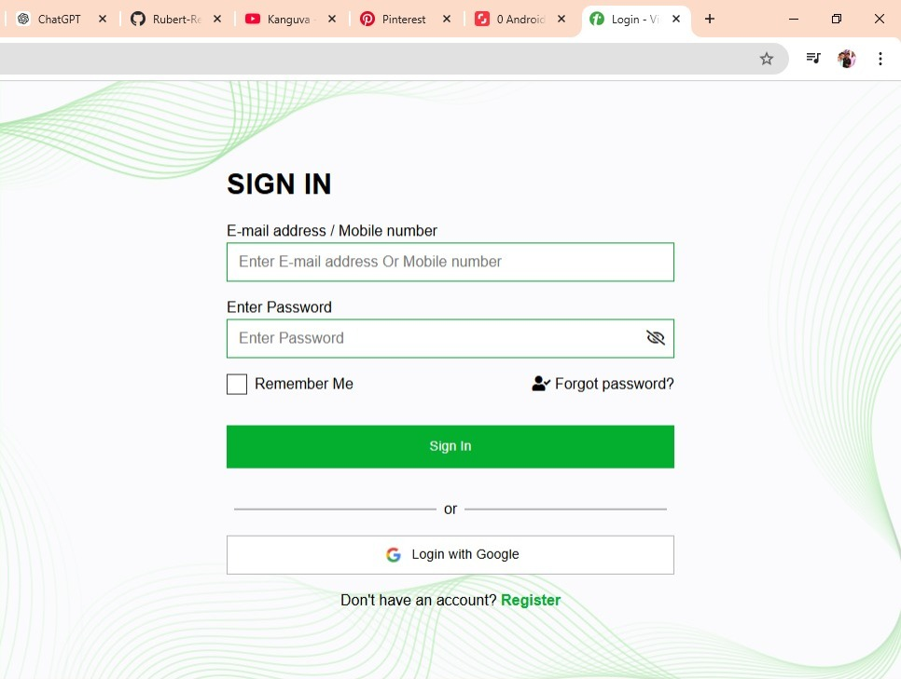

Slide 7
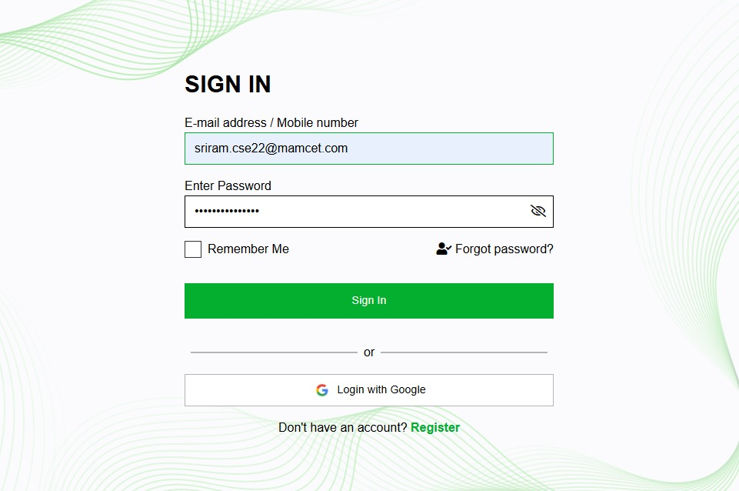

Slide 8
